Slide 1

2_Class Activity 06.07.2020 Case 2B-3 : Team5
Javid Azimi Boulali <A00829592@itesm.mx>
Antonio Osamu Katagiri Tanaka <A01212611@itesm.mx>
Julio Alberto Cao Romero Gallegos <A01327704@itesm.mx>
Bryan Iván Quintanar Abarca <A01751178@itesm.mx>
07 Jul 2020

Slide 2
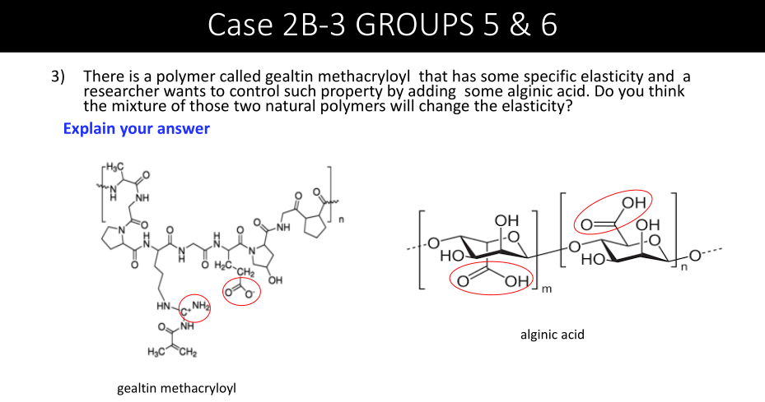
Phenomenon and Problem Explanation
The objective of adding alginic acid to gelatin methacrylate (GelMA) is to modify its viscoelastic property to mimic an extracellular matrix prone to the study of living cells interactions.
The researcher wants to use alginic acid as an additive to modify the elasticity of GelMA and produce methacrylate-alginate (Gel-Alg). A major problem would be the lack of compatibility of both materials, resulting in compromised properties such as: thermal stability or even chemical stability.
[1] Y. X. Chen, B. Cain, P. Soman, Gelatin methacrylate-alginate hydrogel with tunable viscoelastic properties, AIMS Mater. Sci. 4 (2017) 363–369. https://doi.org/10.3934/matersci.2017.2.363.

Slide 3
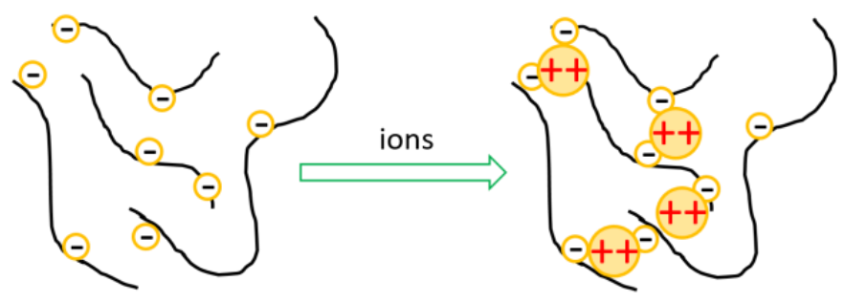
Available Information & Assumptions
Results obtained from creep and compressive tests reveal that the alginate component of Gel-Alg composite, can be effectively crosslinked, un-crosslinked and re-crosslinked by adding or chelating calcium ions.
Polymers use a combination of strong permanent crosslinks and weak bonds that could reversibly break and re-form, to generate a viscoelastic response.
Ions (CaCl2) solution was used to ionically crosslink the alginate component of the UV-crosslinked composite affecting insignificantly its mechanical properties. Alginate acts as the dynamic modifiable element controlled by ionic non-covalent bonding in the presence of calcium divalent ions, while GelMA acts as a stable structural element.
In Gel-Alg, the re-crosslinked states exhibit similar viscoelastic properties to the crosslinked state, confirming that
crosslinking is reversible and this process is capable of dynamically controlling the elastic recovery
[1] Y. X. Chen, B. Cain, P. Soman, Gelatin methacrylate-alginate hydrogel with tunable viscoelastic properties, AIMS Mater. Sci. 4 (2017) 363–369. https://doi.org/10.3934/matersci.2017.2.363.

Slide 4
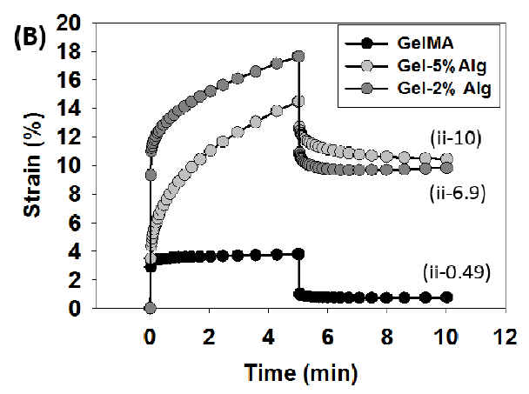
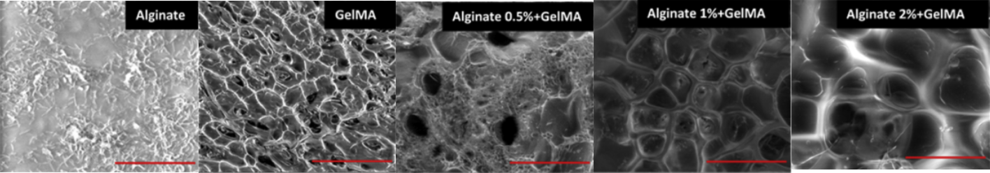
Solution & Justification
Addition of alginate within GelMA exhibits varying degrees of viscoelasticity depending upon the amount of alginate in the composite. The increases in elasticity of the solution is caused by the creation of calcium ions (as ionic crosslinking takes place).
Compressive creep strain plot. Taken from [1]
0.09 kPa
0.77 kPa
0.41 kPa
4.61 kPa
10.67 kPa
[1] Y. X. Chen, B. Cain, P. Soman, Gelatin methacrylate-alginate hydrogel with tunable viscoelastic properties, AIMS Mater. Sci. 4 (2017) 363–369. https://doi.org/10.3934/matersci.2017.2.363.
[2] R. Kadri, J. Bacharouch, K. Elkhoury, G. Ben Messaoud, C. Kahn, S. Desobry, M. Linder, A. Tamayol, G. Francius, J.F. Mano, L. Sánchez-González, E. Arab-Tehrany, Role of active nanoliposomes in the surface and bulk mechanical properties of hybrid hydrogels, Mater. Today Bio. 6 (2020) 100046. https://doi.org/10.1016/j.mtbio.2020.100046.

Slide 5
Conclusions:
Literature demonstrates that Gel-Alg obtained its viscoelastic strain and elastic recovery properties and can be potentially used to design extracellular matrix mimicking hydrogels.

Slide 6
Class Discussion:
In this case the carboxylic acid (carbon, double bond, oxygen) opens the possibility of having a salt like sodium in the GelMA and the alginic acid.
If the sodium hydroxide in the GelMA comes in contact with alginic acid, a salt will be produced. Then the sodium salt dissolves in the water. Meaning that the carboxylic acid becomes negatively charged.
Regarding the presence of NH2 in GelMA, the NH2 part becomes positively charged with the addition of acid. Therefore the NH2 part is linked to the carboxylic acid part in the alginic acid. Moreover, the hydrogen in the alginic acid (within the red circle) is partially negative due to the dissociation of electrons with the oxygen atom.
Furthermore, calcium ions have the ability to connect because they have “double positive” ions, so one of them can connect with the OH of the alginic acid, and the other to the O- (within the red circle) of GelMA.
These crosslink ionic bonds can be amended by the addition of water, changing the stiffness of the material. (whereas covalent crosslinking cannot be amended to change the stiffness). Since, sodium is more soluble than calcium in water, the addition of sodium will displace the calcium and the material becomes malleable. On the other hand, the addition of calcium will contribute to the stiffness of the material since it is prone to precipitate.
If electricity is applied to this material, the chains will align. This alignment shrink or to expand the material (also changing the stiffness) in such a way that the material can simulate muscles.

Slide 7


Slide 8
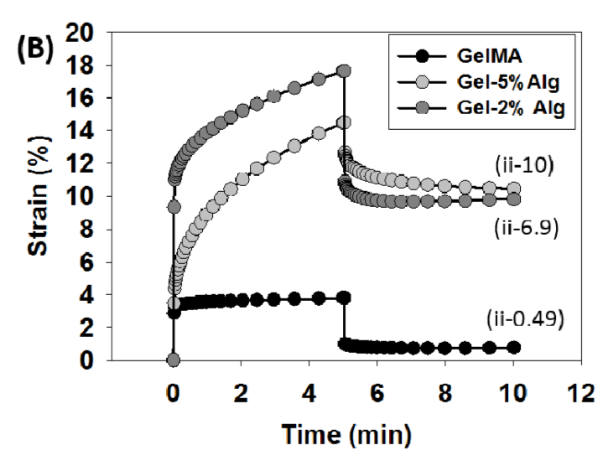
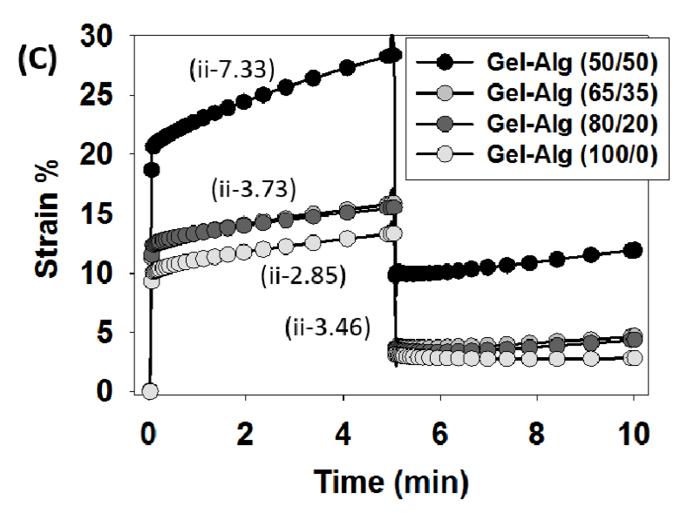
Creep test
Pure GelMA
0.49% viscoelastic strain (5 min)
GelMA-Alginate composite (50/50 Gel-Alg)
viscoelastic stain: 6.9% (2% alginate)
viscoelastic stain: 10% (5% alginate)
The viscoelastic strain of Gel-Alg composite decreases with decreasing amounts of alginate
viscoelastic stain: 7.33% (50:50 GelMA: Alginate)
viscoelastic stain: 3.73% (65:35 GelMA: Alginate)
viscoelastic stain: 3.46% (80:20 GelMA: Alginate)
viscoelastic stain: 2.85% (100:0 GelMA: Alginate)
Purely covalently UV-crosslinked GelMA results in a predominantly elastic material
[1] Y. X. Chen, B. Cain, P. Soman, Gelatin methacrylate-alginate hydrogel with tunable viscoelastic properties, AIMS Mater. Sci. 4 (2017) 363–369. https://doi.org/10.3934/matersci.2017.2.363.

